Slide 1
Tag helpers

Slide 2
What are tag helpers?
Similar to HTML helpers , Tag Helpers enable server-side code to participate in creating and rendering HTML elements in Razor pages.
IntelliSense Support.
There are many built-in Tag Helpers for common tasks, such as creating forms, links, …..etc.
Example: LabelTagHelper can target the HTML <label> element when the LabelTagHelper attributes are applied.

Slide 3
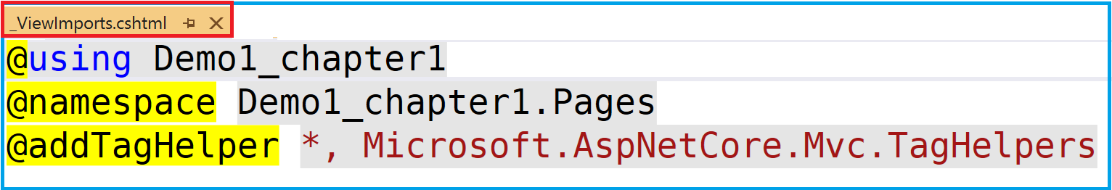
Register tag helpers
ViewImports.CSHTML
If you plan on using tag helpers throughout the application, you can add the @addTagHelper directive inside the ViewImports file as shown above. (register all the tag helpers in the assembly Microsoft.AspNet.Mvc.TagHelpers"
You can also place the @addTagHelper directive into an individual page

Slide 4
The Input Tag Helper
<form method="post">
<input asp-for="Member.PersonId" /><br />
<input asp-for="Member.Name" /><br />
<input asp-for="Member.Email" /><br />
public class RegisterModel : PageModel
{
[BindProperty]
public Member Member { get; set; }
public void OnGet()
{
}
public void OnPost()
{
}
}
public class Member
{
public int PersonId { get; set; }
public string Name { get; set; }
[EmailAddress]
public string Email { get; set; }
}

Slide 5
The Input Tag Helper
optional
<form method=“Get">
<input asp-for="Member.PersonId" /><br />
<input asp-for="Member.Name" /><br />
<input asp-for="Member.Email" /><br />
public class RegisterModel : PageModel
{
[BindProperty(SupporsGet=true]
public Member Member { get; set; }
public void OnGet()
{
}
public void OnPost()
{
}
}
public class Member
{
public int PersonId { get; set; }
public string Name { get; set; }
[EmailAddress]
public string Email { get; set; }
}

Slide 6
The Label Tag Helper The label tag helper generates appropriate for attribute values and content based on the PageModel property that is assigned to it.
Example:
<label asp-for="Email”></label>
This renders as
<label for="Email”>Email</label>

Slide 7
The Anchor tag helper
The name of the Razor page to link to must be provided without the file extension: <a asp-page="page">Click</a>.
This renders as <a href="page">Click</a>
If no valid page name is specified, the tag helper will generate a link to the current page: <a asp-page=" ">Click</a>
If you want to generate a link to the default page in a folder, you must include the default page's file name: <a asp-page="/folder/index">Back to index</a>

Slide 8
The Anchor tag helper
The route- attribute enables you to specify the value for a single route data parameter. Usefull when passing data (i.e. the id) from one page to another. An example is when editing a specific item in a collection.
The parameter name is added after the hyphen.
Example: If the route parameter name is “id": <a asp-route-id=“value">Click</a> Example: If the route parameter name is “title": <a asp-route-title=“value">Click</a>

Slide 9
The Anchor tag helper
<a asp-page=“page” asp-route-id=“value“ >Click</a>
When navigating to the new page, the value of the id is passed either as :
The route parameter ( if it is defined as part of the page´s route template)
otherwise, it is passed as a queryString
The id is captured as the parameter of OnGet and OnPost methods

Slide 10
The Anchor tag helper
The asp-page-handler is used to set a specific handler.
<a asp-page=“page”
asp-page-handler=“handler_method“ >Click</a>

Slide 11
The Select Tag Helper
The role of the Select tag helper is to render an HTML Select element populated with options generated from :
An enumeration
A collection SelectListItem objects,
And/or options set via the option tag helper.

Slide 12
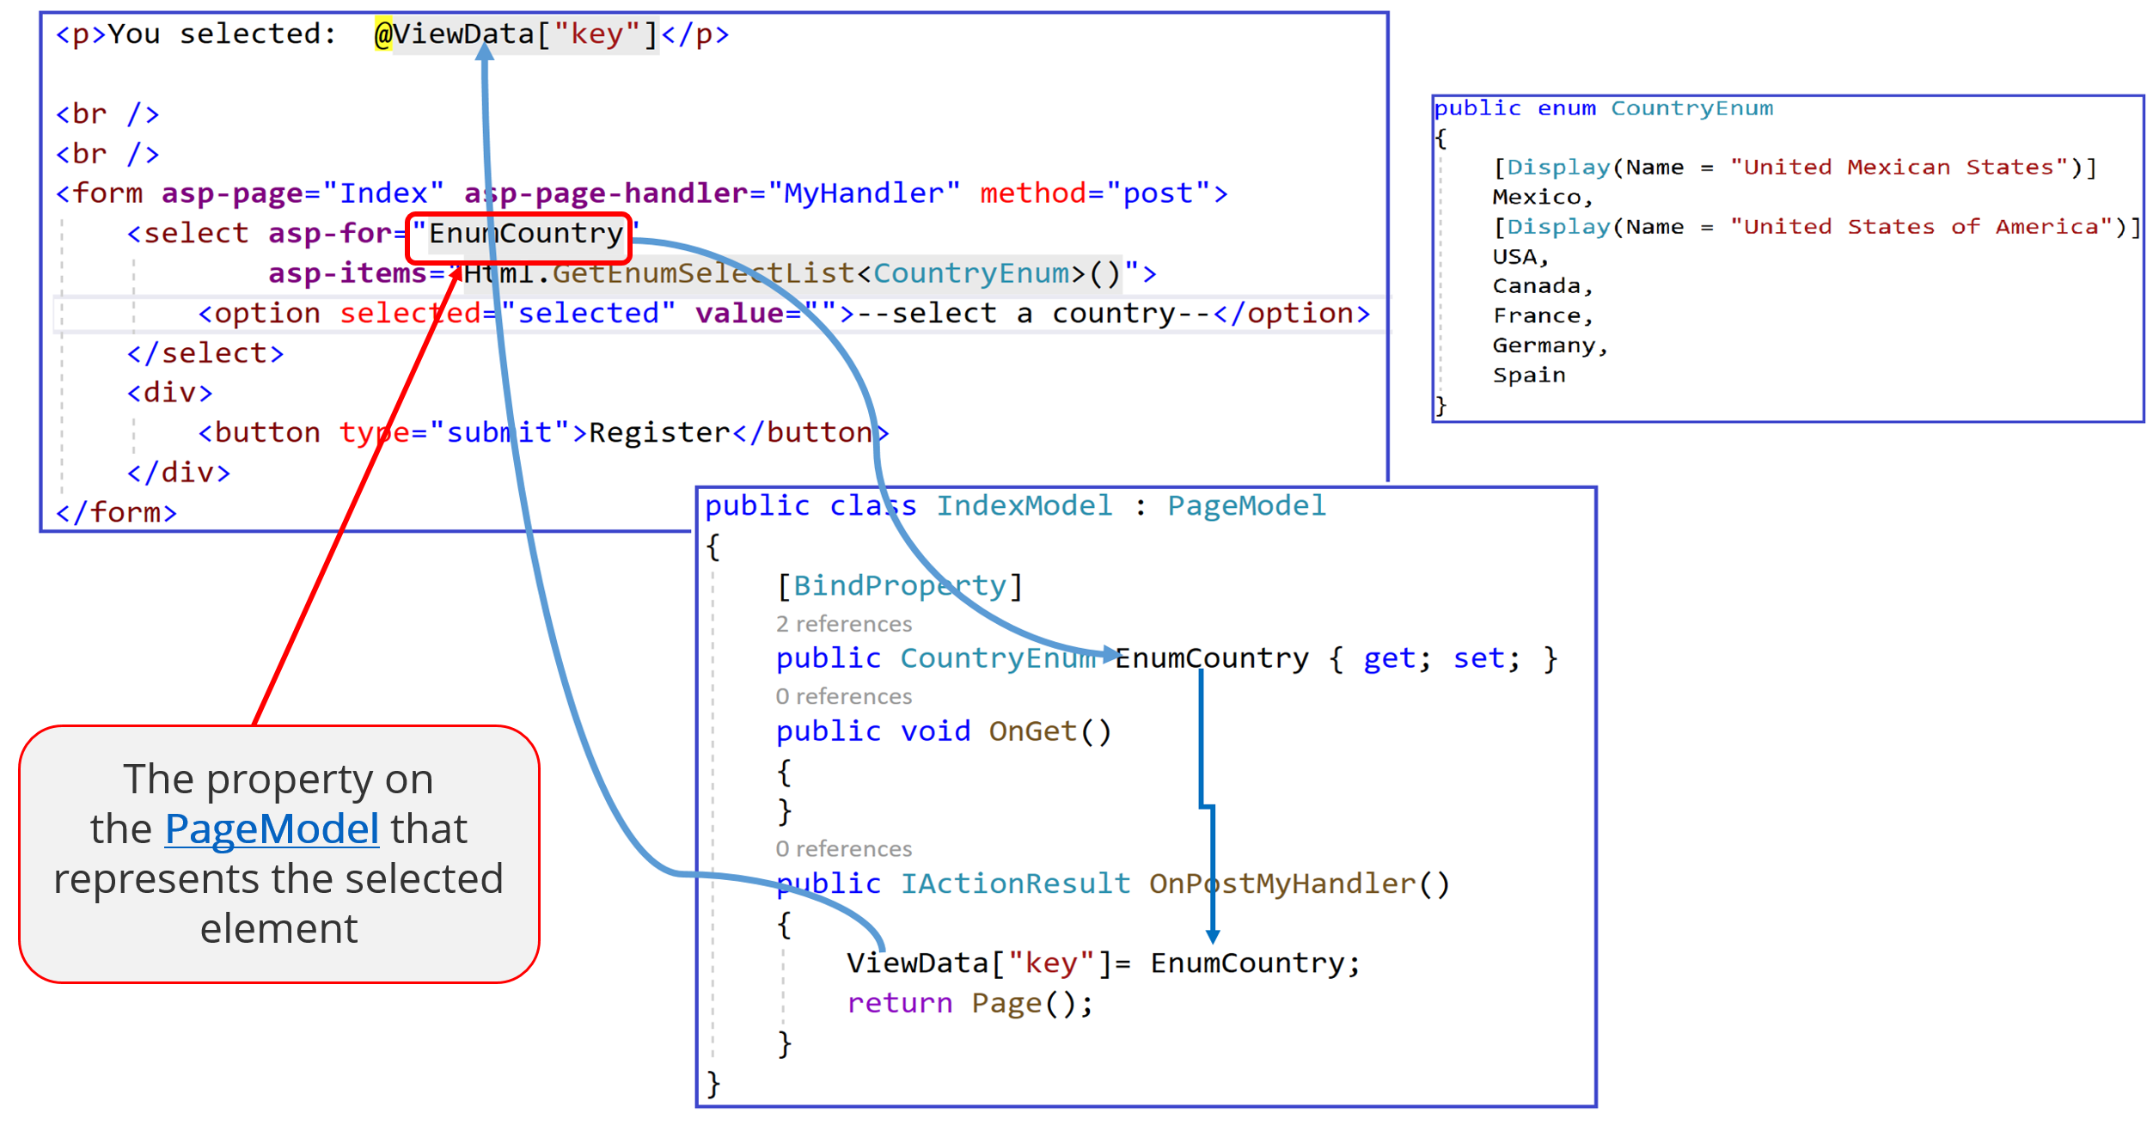
Enumeration
.

Slide 13
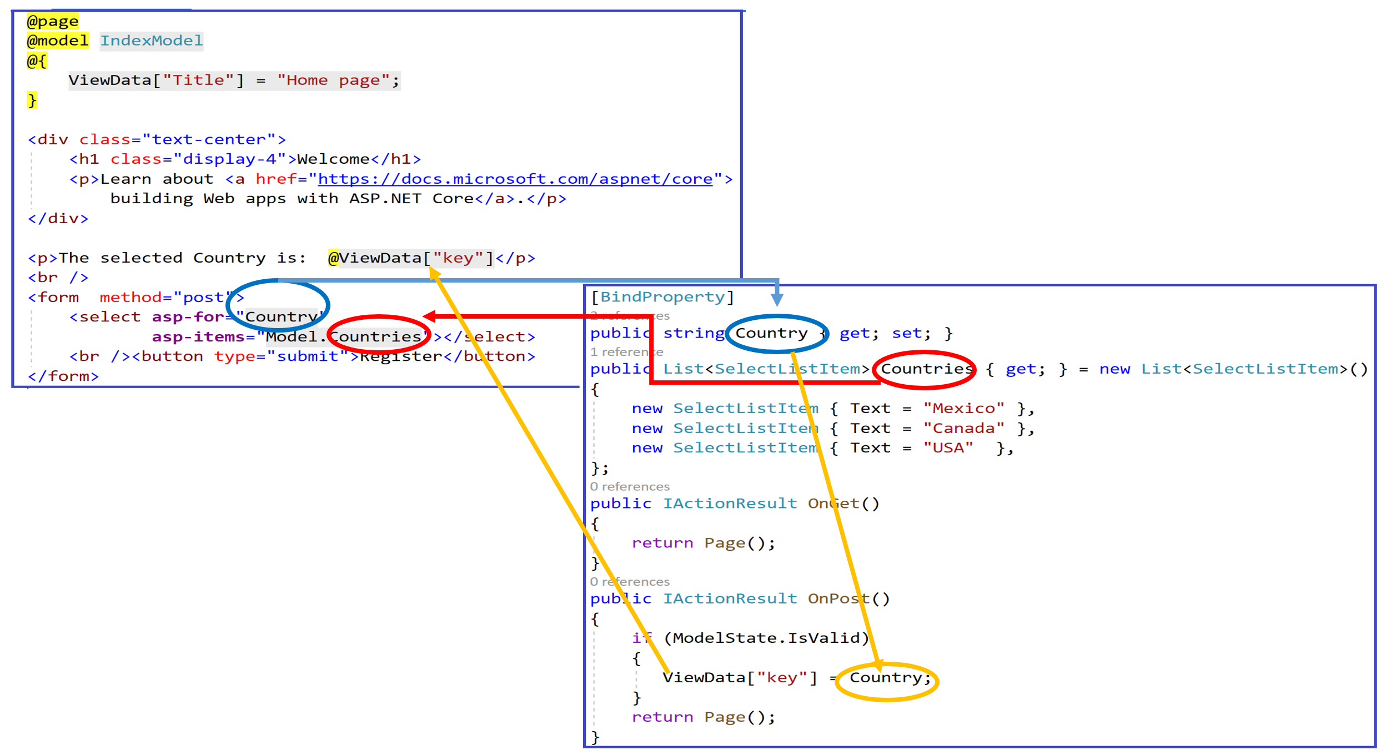
SelectListItem

Slide 14
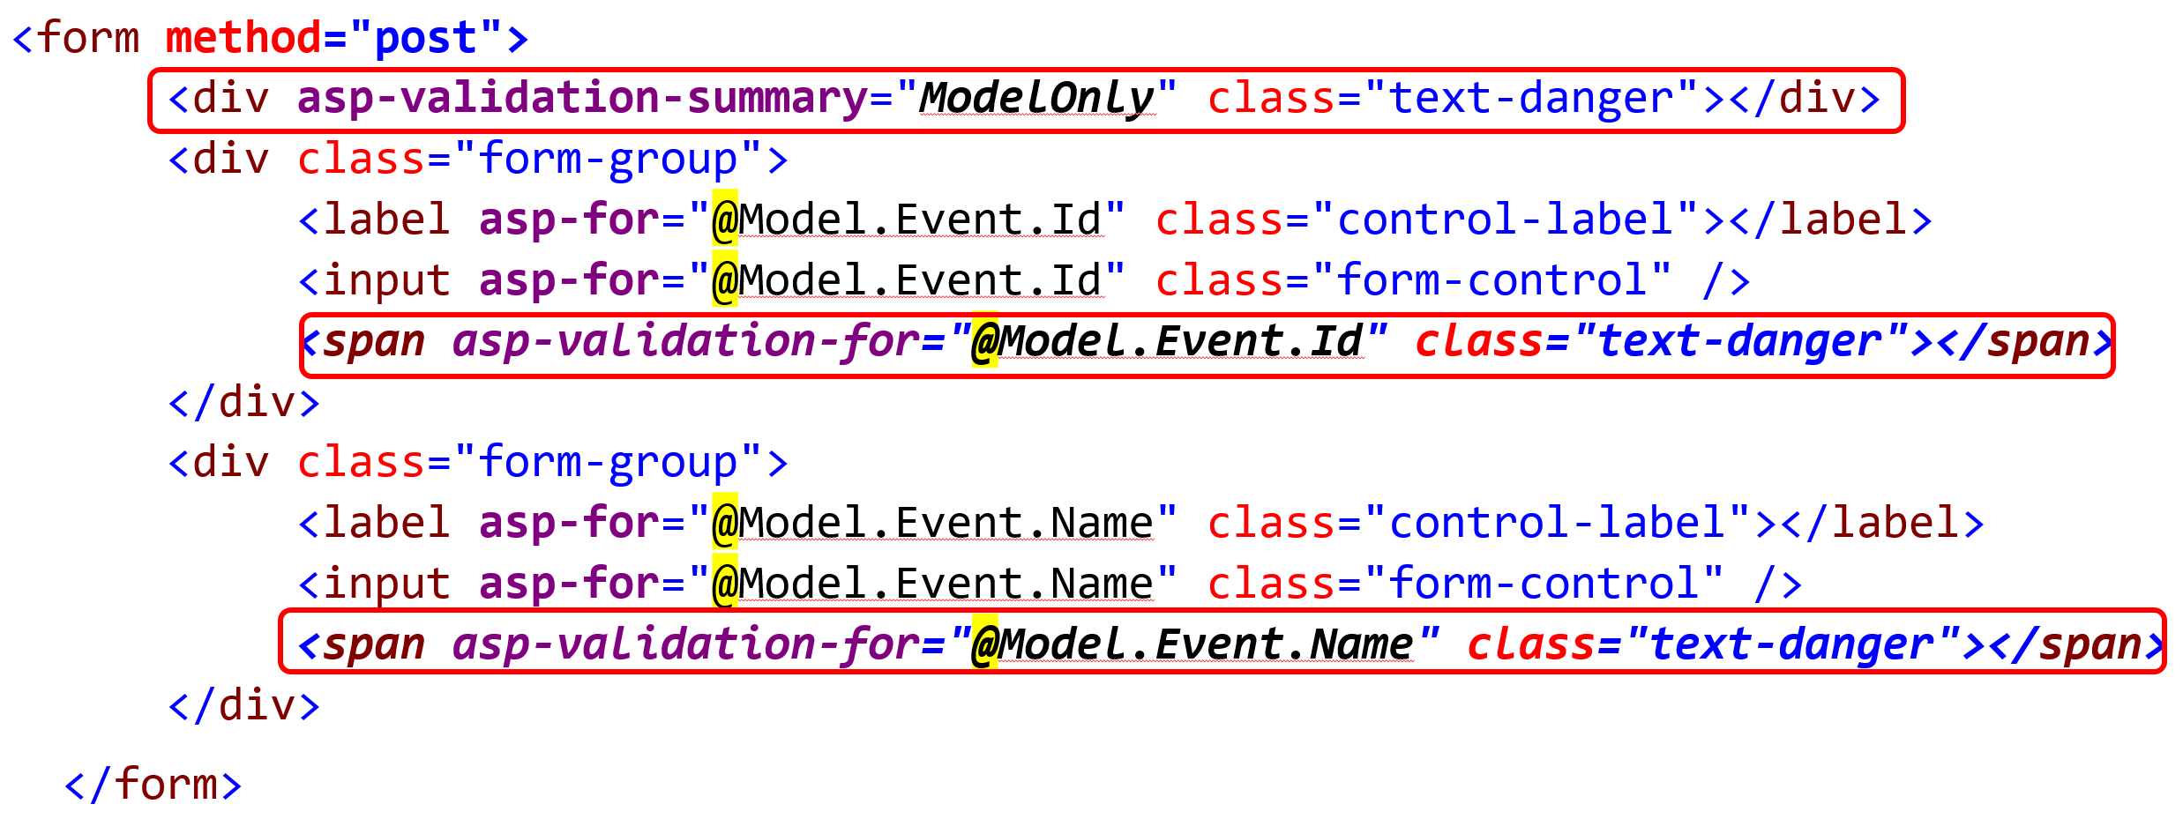
The Validation Tag Helper
The validation tag helper targets the HTML span element, and is used to render property-specific validation error messages.

Slide 15
Demo
In this Demo , we are going to look at the use of :
asp-page
asp-page-handler
asp-route-id
asp-for
asp-label
asp-items
asp-validation-for
asp-validation-summary

